Slide 1
Classification Model for Lesion Images on the HAM10000 Dataset
Conor Huh, Mridul Jain, Vishal Saxena, Lynne Wang
MIDS 281 Computer Vision, UC Berkeley
Notes:
Vishal ---

Slide 2

Presentation Roadmap
Addressing Class Imbalance in the HAM Dataset: Upsampling Techniques
Feature Extraction: Simple and Complex Approaches for Lesion Classification
Feature Selection Rationale and Interpretation
Classification Methods and Performance Analysis
Ensuring Generalizability: Data Splitting, Hyperparameter Search, and Evaluation
Balancing Efficiency and Accuracy: Comparative Analysis of Feature-Classifier Combinations
Notes:
Vishal ---

Slide 3
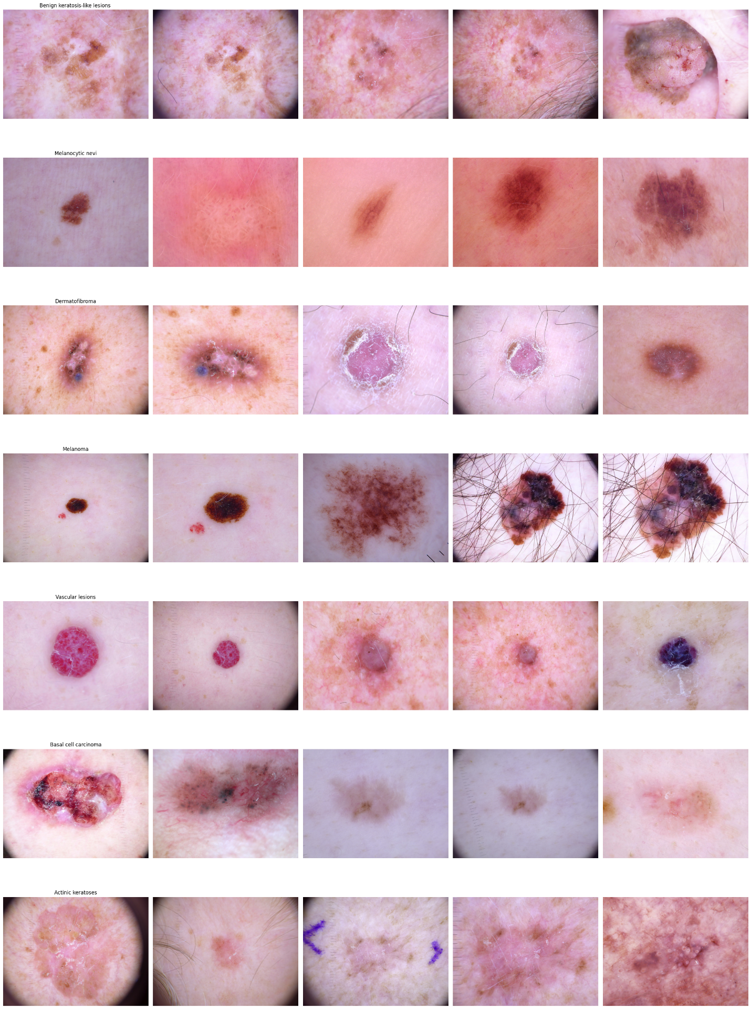
Overview of the HAM Lesion Dataset
Notes:
Vishal ---

Slide 4
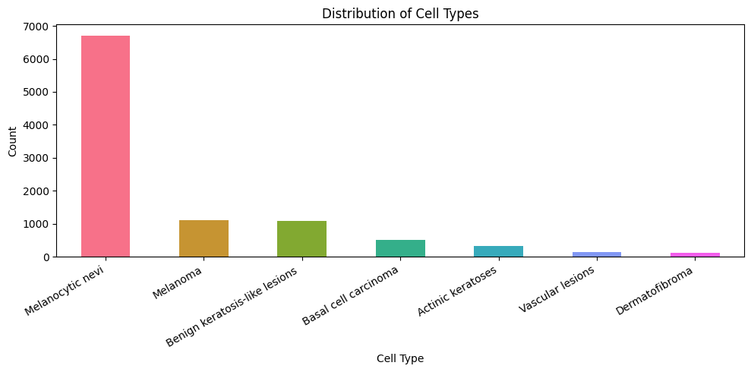
Addressing Class Imbalance in the HAM Dataset: 1. Oversampling 2. Class Weighting
Notes:
Vishal

Slide 5
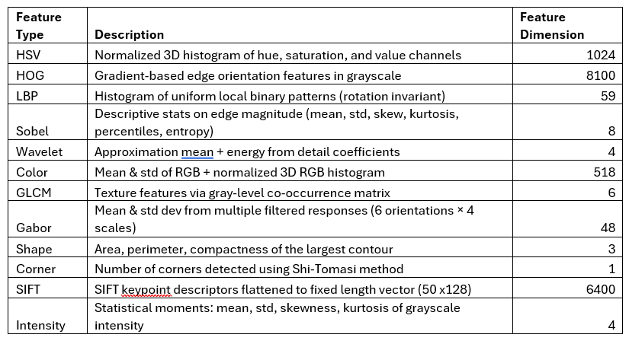
Simple Feature Extraction
Notes:
Vishal

Slide 6
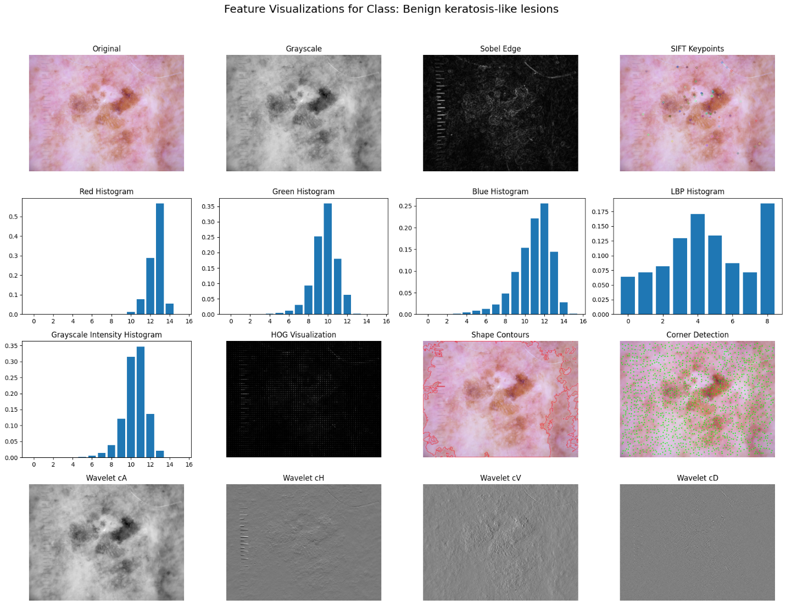
Visualization of Simple Features
Notes:
Vishal,
Lynne – explored removing ruler and hair, which did not improve the model.

Slide 7
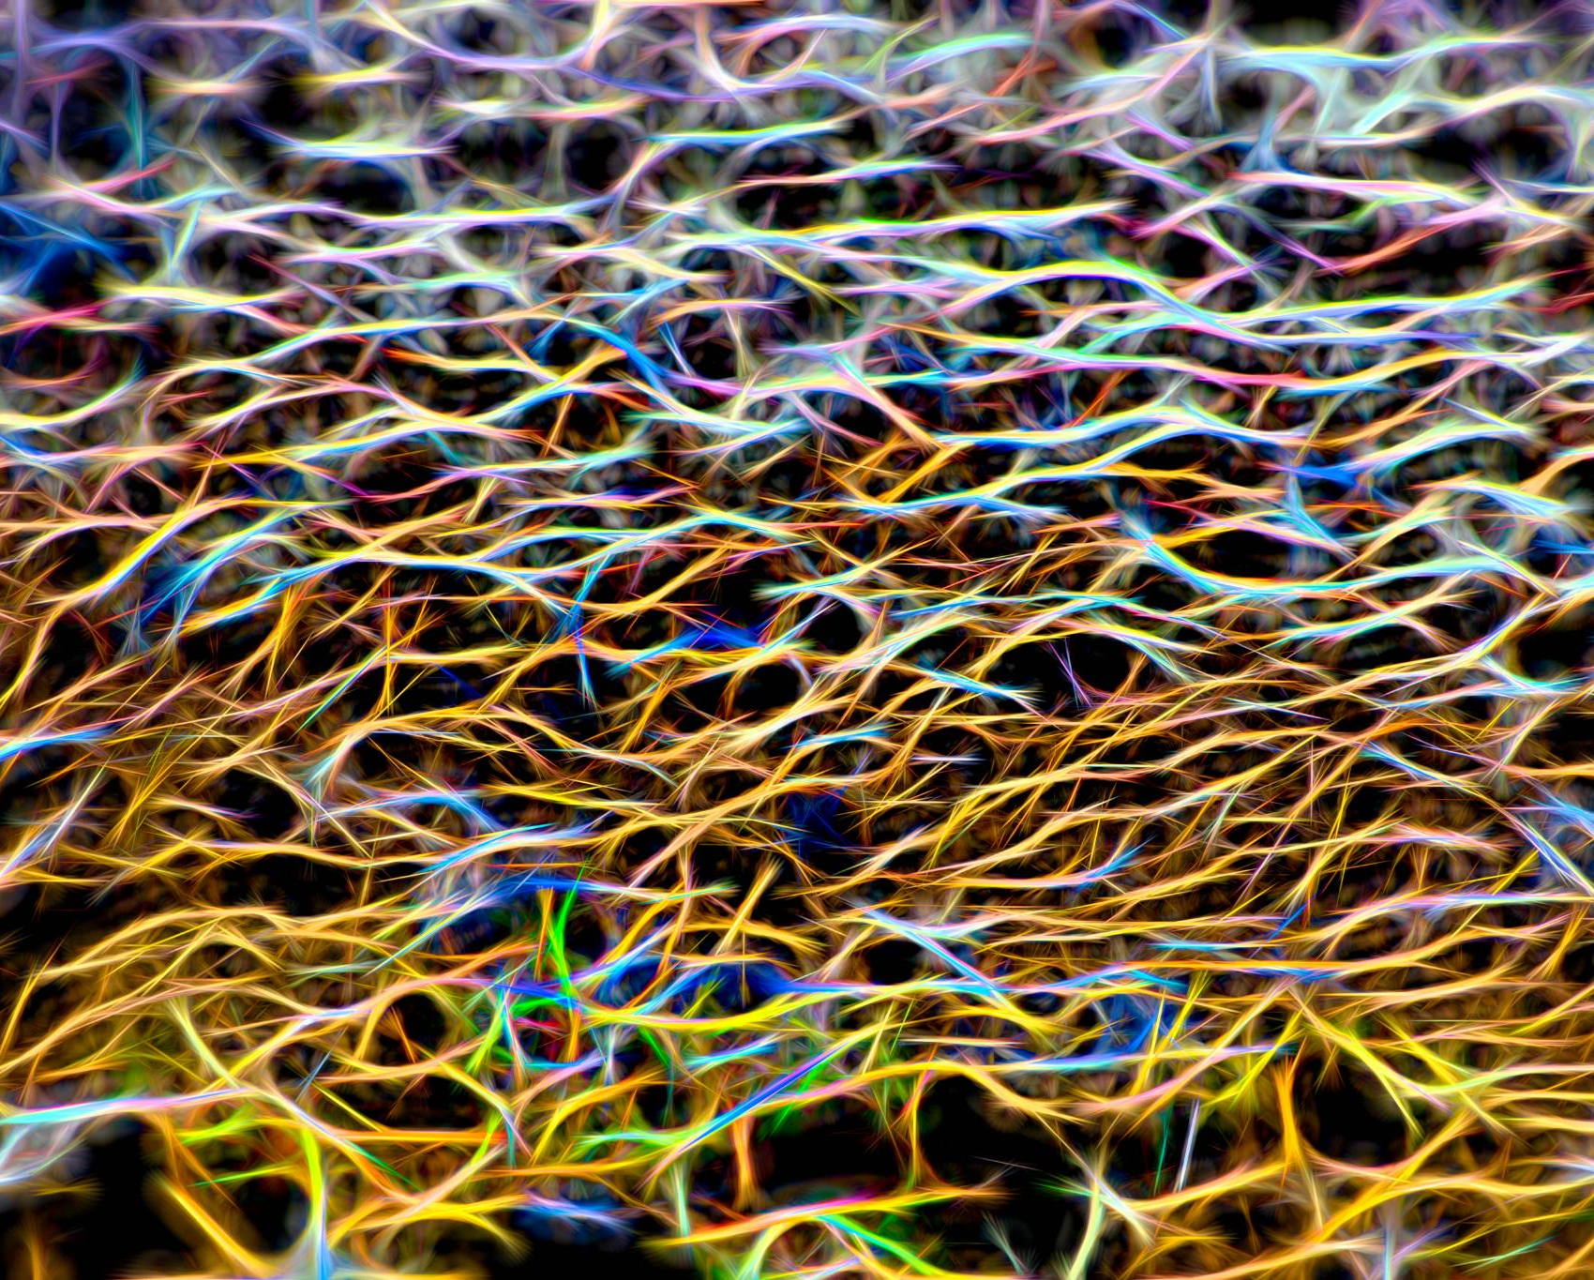
Complex Feature Extraction: 1. Vit 2. Clip
3. Resnet
Notes:
Mridul – embedding model – potential contrastive learning in the future

Slide 8
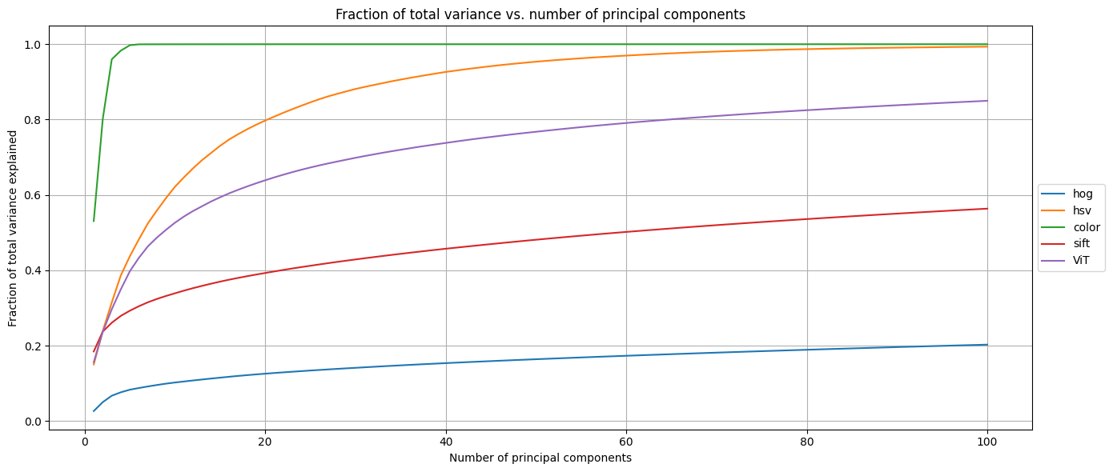
PCA of High Dimensional Features
Notes:
Mridul

Slide 9
AUC-ROC of Each Feature
 | mean_auc_roc | akiec | bcc | bkl | df | mel | nv | vasc
ViT | 0.918807 | 0.940296 | 0.946014 | 0.887043 | 0.913504 | 0.85162 | 0.908344 | 0.984825
color | 0.905113 | 0.903213 | 0.915098 | 0.86108 | 0.885808 | 0.881939 | 0.899282 | 0.989368
hsv | 0.900603 | 0.896002 | 0.910165 | 0.853191 | 0.867202 | 0.887739 | 0.897905 | 0.992014
gabor | 0.782414 | 0.881289 | 0.810262 | 0.734217 | 0.734684 | 0.777433 | 0.814387 | 0.724627
lbp | 0.741303 | 0.886965 | 0.730321 | 0.660882 | 0.672998 | 0.739452 | 0.801442 | 0.697058
glcm | 0.72045 | 0.829348 | 0.74523 | 0.680216 | 0.706693 | 0.730609 | 0.797681 | 0.553369
sobel | 0.709296 | 0.79191 | 0.722999 | 0.631536 | 0.59653 | 0.717012 | 0.76058 | 0.744508
sift | 0.701086 | 0.805895 | 0.732431 | 0.676648 | 0.618868 | 0.761287 | 0.754935 | 0.557536
intensity | 0.684763 | 0.7843 | 0.750177 | 0.642779 | 0.616066 | 0.689608 | 0.733427 | 0.576982
X_wavelet | 0.631446 | 0.746668 | 0.615292 | 0.554721 | 0.553793 | 0.676672 | 0.673983 | 0.598994
hog | 0.618517 | 0.747637 | 0.566517 | 0.599901 | 0.592902 | 0.557032 | 0.624516 | 0.641112
shape | 0.614213 | 0.708403 | 0.657218 | 0.614838 | 0.527211 | 0.541862 | 0.677848 | 0.572112
corners | 0.507599 | 0.500864 | 0.503842 | 0.501728 | 0.514527 | 0.5002 | 0.500283 | 0.531749
Notes:
Mridul

Slide 10
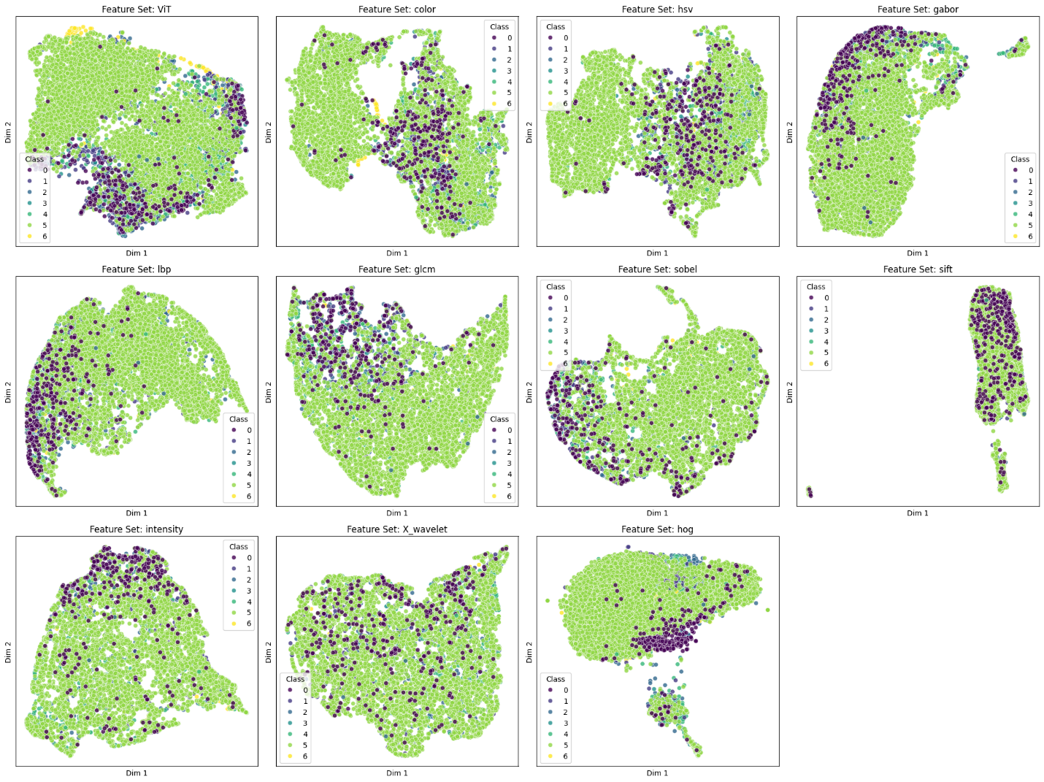
2D Visualization of Features
Notes:
Mridul

Slide 11
Training and Evaluation Strategies
Notes:
Conor

Slide 12
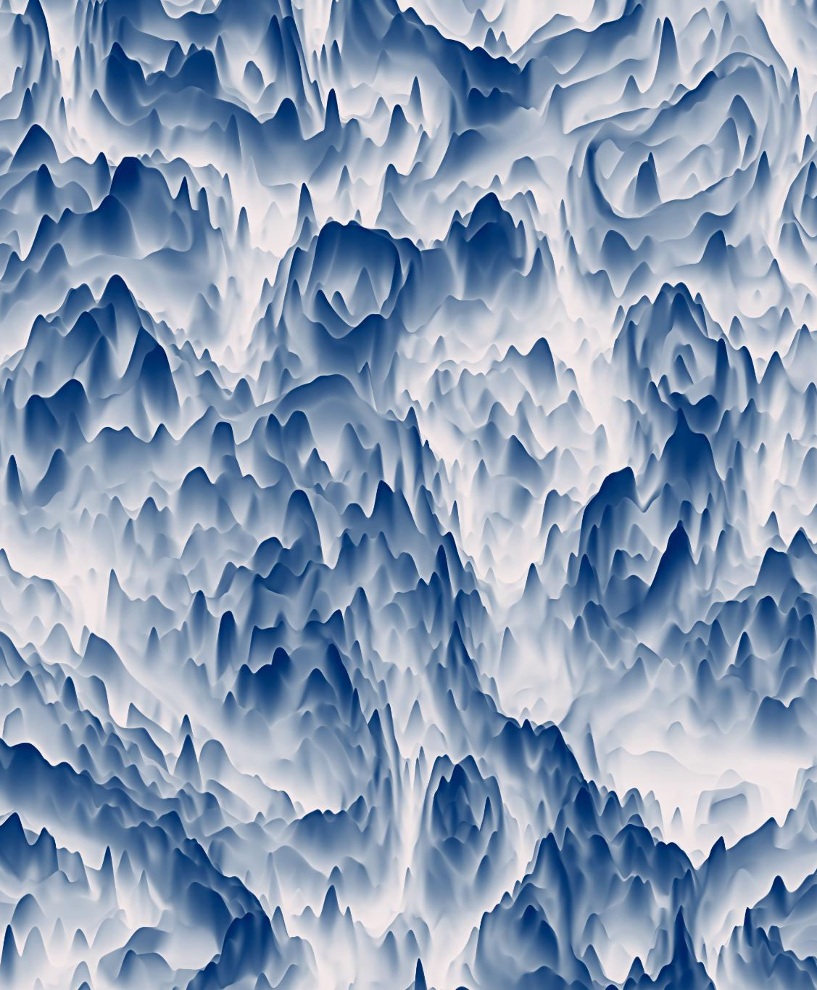
K-Fold + Oversampling or Class-Weighting
We first performed a stratified 80/20 train-test split, ensuring class distribution was preserved. The 20% test set was held out entirely for final evaluation.
The 80% training set was then further split (80/20) into training and validation subsets, and used with 5-fold Stratified K-Fold Cross-Validation for robust hyperparameter tuning.
We used Bayesian optimization (BayesSearchCV) with 5-fold cross-validation to identify optimal hyperparameters. For each hyperparameter candidate, five models were trained and evaluated across folds, and the average performance (macro F1 or AUC-ROC) was used to guide optimization.
After selecting the best hyperparameters, a final model was retrained on the entire 80% training set, incorporating the same oversampling or class-weighting strategy.
Threshold tuning was performed on the validation set to improve class-wise decision boundaries and enhance macro F1 performance on the multiclass task.
Notes:
Conor

Slide 13
Model Performance
F1 Optimized Models w/ Oversampling
Model | Train Time (s) | Inference Time (s) | Best CV F1-Macro | Test Set AUC-ROC | Test Accuracy | Test Macro F1-Score | Best Hyperparameters
XGB* | 2364.96 | 0.11 | 0.6752 | 0.9699 | 0.8509 | 0.7407 | lr=0.29, max_depth=3, n_est=491
LS | 347.99 | 0.03 | 0.6556 | 0.9534 | 0.7902 | 0.6712 | C=2.07, penalty='l1'
RF | 347.47 | 0.31 | 0.5585 | 0.9347 | 0.6983 | 0.6119 | max_depth=10, n_bins=19, n_est=500
KNN | 105.28 | 0.17 | 0.3423 | 0.6654 | 0.613 | 0.3496 | n_neighbors=3, p=2
AUC-ROC Optimized Models w/ Oversampling
Model | Train Time (s) | Inference Time (s) | Best CV AUC-ROC | Test Set AUC-ROC | Test Accuracy | Test Macro F1-Score | Best Hyperparameters
XGB | 707.4 | 0.11 | 0.9566 | 0.9649 | 0.8268 | 0.6948 | lr=0.30, max_depth=3, n_est=412
RF | 86.32 | 0.3 | 0.9435 | 0.9514 | 0.7907 | 0.6229 | max_depth=45, n_bins=18, n_est=500
LR | 347.99 | 0.03 | 0.9385 | 0.9534 | 0.7987 | 0.6761 | C=0.69, penalty='l1'
KNN | 6.96 | 0.07 | 0.7335 | 0.7221 | 0.5452 | 0.3142 | n_neighbors=30, p=2
Notes:
Mridul

Slide 14
Model Performance
F1 Optimized Models w/ Class Balancing
Model | Train Time (s) | Inference Time (s) | Best CV F1-Macro | Test Set AUC-ROC | Test Accuracy | Test Macro F1-Score | Best Hyperparameters
XGB | 2038.62 | 0.05 | 0.6244 | N/A | 0.8333 | 0.6887 | lr=0.16, max_depth=5, n_est=319
LR | 1627.75 | 0.02 | 0.6369 | N/A | 0.8047 | 0.6742 | C=62.71, penalty='l1'
RF | 302.21 | 0.43 | 0.4007 | N/A | 0.7585 | 0.4048 | max_depth=33, n_bins=101, n_est=212
KNN | 84.33 | 0.09 | 0.3142 | N/A | 0.7083 | 0.3421 | n_neighbors=15, p=2
AUC-ROC Optimized Models w/ Class Balancing
Model | Train Time (s) | Inference Time (s) | Best CV AUC-ROC | Test Set AUC-ROC | Test Accuracy | Test Macro F1-Score | Best Hyperparameters
XGB | 151.56 | 0.05 | 0.9499 | 0.9587 | 0.8228 | 0.6638 | lr=0.17, max_depth=14, n_est=187
LS*** | 76.91 | 0.02 | 0.9457 | 0.9472 | 0.7942 | 0.5898 | C=105.76, penalty='l2'
RF | 21.97 | 0.27 | 0.9352 | 0.9504 | 0.7952 | 0.5842 | max_depth=23, n_bins=95, n_est=470
KNN** | 1.14 | 0.04 | 0.827 | 0.8194 | 0.7063 | 0.3261 | n_neighbors=26, p=2
Notes:
Mridul

Slide 15
Our Best Model
Class | Precision | Recall | F1-Score | Support
0 (Actinic keratoses) | 0.683333 | 0.621212 | 0.650794 | 66
1 (Basal cell carcinoma) | 0.712766 | 0.650485 | 0.680203 | 103
2 (Benign keratosis-like lesions) | 0.684932 | 0.688073 | 0.686499 | 218
3 (Dermatofibroma) | 0.866667 | 0.565217 | 0.684211 | 23
4 (Melanoma) | 0.711538 | 0.666667 | 0.688372 | 222
5 (Melanocytic nevi) | 0.913931 | 0.940691 | 0.927118 | 1332
6 (Vascular lesions) | 0.92 | 0.821429 | 0.867925 | 28
accuracy | 0.850904 | 0.850904 | 0.850904
macro avg | 0.784738 | 0.707682 | 0.740732 | 1992
weighted avg | 0.847812 | 0.850904 | 0.848619 | 1992
Notes:
Mridul

Slide 16
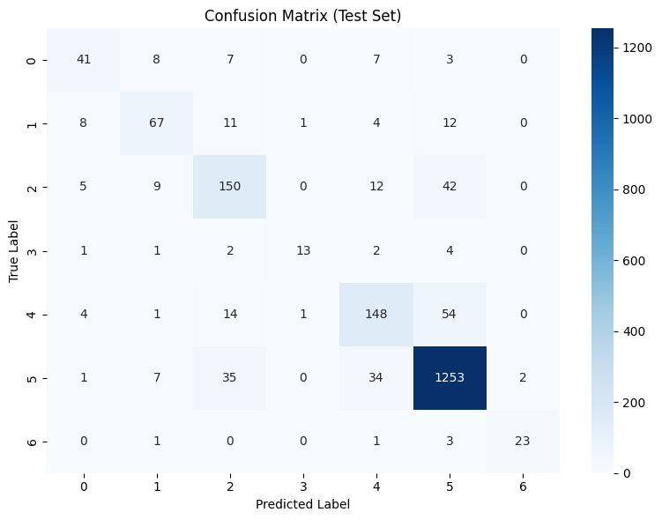
Our Best Model
Notes:
Conor, Lynne

Slide 17
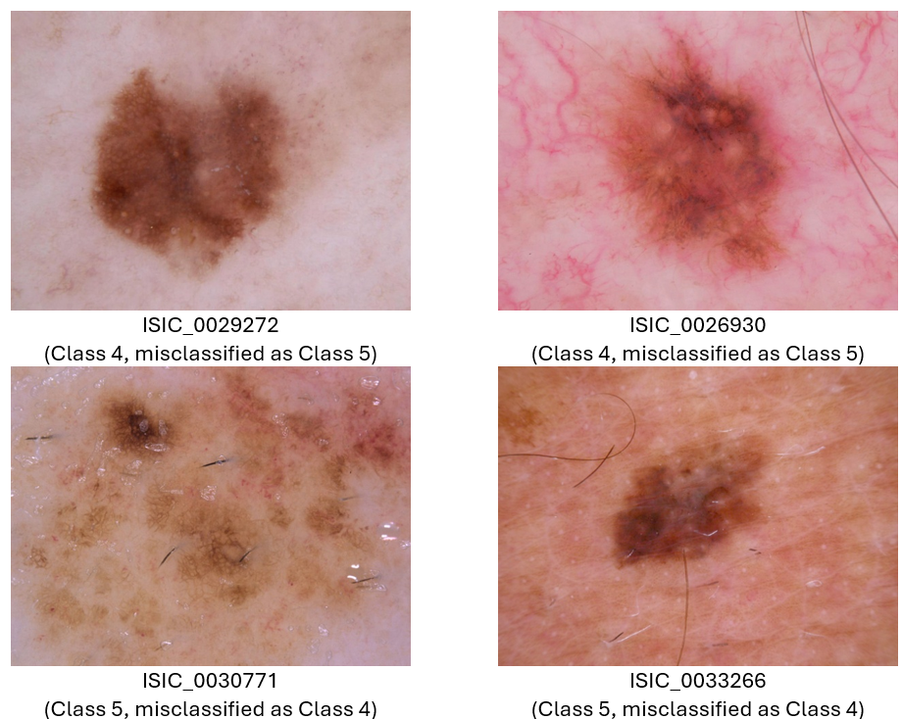
Case Analysis: Misclassification Between Class 4 and Class 5
Notes:
Lynne, Mridul

Slide 18

Future Work:
Feature Refinement and Expansion: revisiting shape, boundary, color, and edge-based features—possibly with expert guidance—to better capture lesion structure and improve class separability.
Preprocessing Enhancements: Using lesion localization and contrast enhancement may help the model focus more directly on relevant lesion areas while reducing background noise.
Fine-Tuning Embeddings with Contrastive Learning: using contrastive learning, to better capture lesion-specific representations and improve separability across classes.
Model Ensembling, which may enhance robustness and per-class recall, especially for rare lesion categories.
Real-World Validation, to evaluate model performance on out-of-distribution data and assess generalizability beyond the HAM10000 dataset.
Notes:
Mridul

Slide 19
Thank You!

